Slide 1
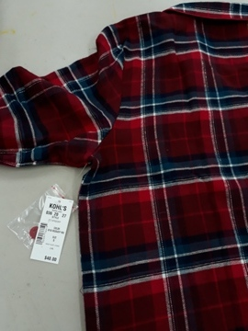
Packing way S#ZC74P005-006RP-RPL-EP-PP Hangtag placement (For Bulk & E.com)
Use 3" white plastic string fix together Hangtag
and spare button bag on wearer’s left armhole.

Slide 2
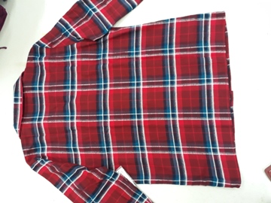
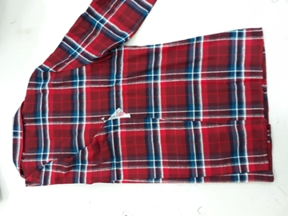
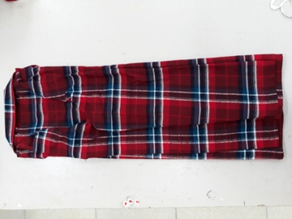
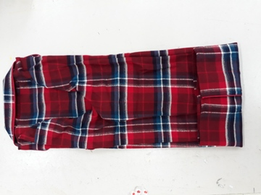
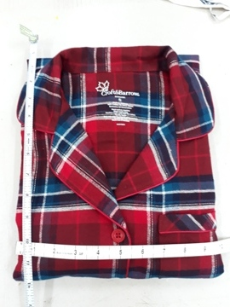
S#ZC74P005-006RP-RPL-EP-PP – TOP FOLDING STEPS
Step 1: Flat back garment.
Step 2: Fold left & right sleeve/ side to central.
Step 4: Fold half –
The top done with L=12”, W=10”
Step 3: Fold back from hem.

Slide 3
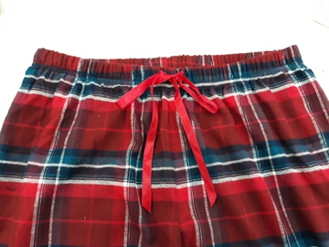
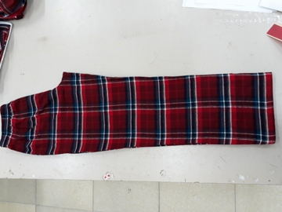
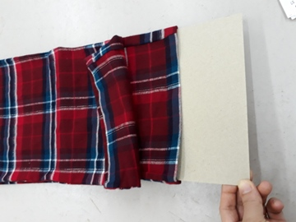
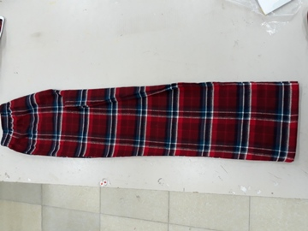
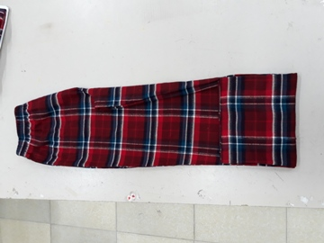
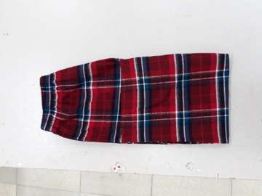
S#ZC74P005-006RP-RPL-EP-PP - PANT FOLDING STEPS
Step 1: Bow the tied draw cord inside, then put cardboard on the bottom
of the pants when they are laying flat and slide into inner side.
Step 2: Fold the crotch
to the central.
Step 3: Fold back the pants.

Slide 4
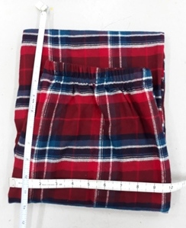
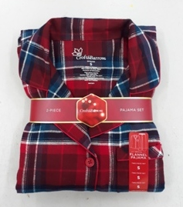
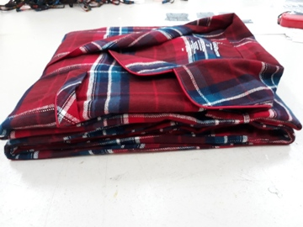
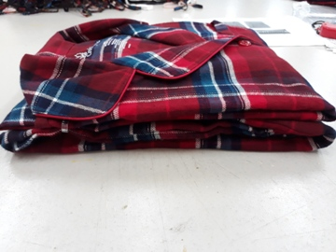
S#ZC74P005-006RP-RPL-EP-PP – PANT/TOP FOLDING STEPS
Step 4:
Pants done with L=12”, W=10”
Step 5: Put Top on Pants with belly band, sets done with L=12”, W=10” (size stripe 1” from the right side edge; ¾ of size sticker on the top of garment.
¼ of size sticker on the bottom of garment).
Waistband need to be at least at the middle or higher
2 clear clips in total.
One per each side.
1”

Slide 5
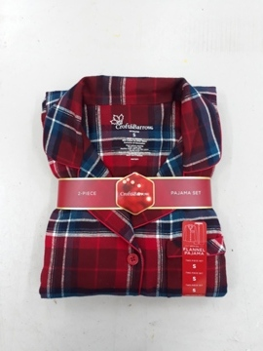
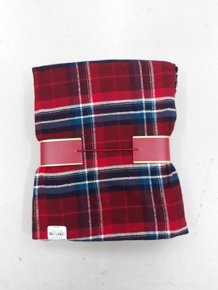
S#ZC74P005-006RP-RPL-EP-PP – PANT/TOP FOLDING STEPS
Front
Back

Slide 6
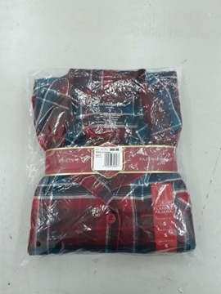
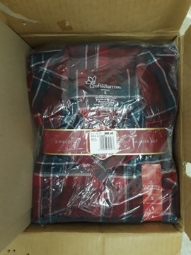
S#ZC74P005-006RP-RPL-EP-PP – PANT/TOP PUT INTO CARTON (For E.Com PO)
Each garment put into one poly bag with gum sticker
and put into carton follow ratio in EDI & PM

Slide 7
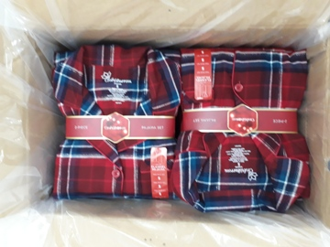
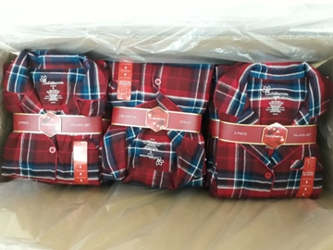
S#ZC74P005-006RP-RPL-EP-PP – PANT/TOP PUT INTO CARTON (For Bulk PO)
Follow ratio in EDI & PM: 12 set or 24 set pack a poly bag then into a carton

